Slide 1


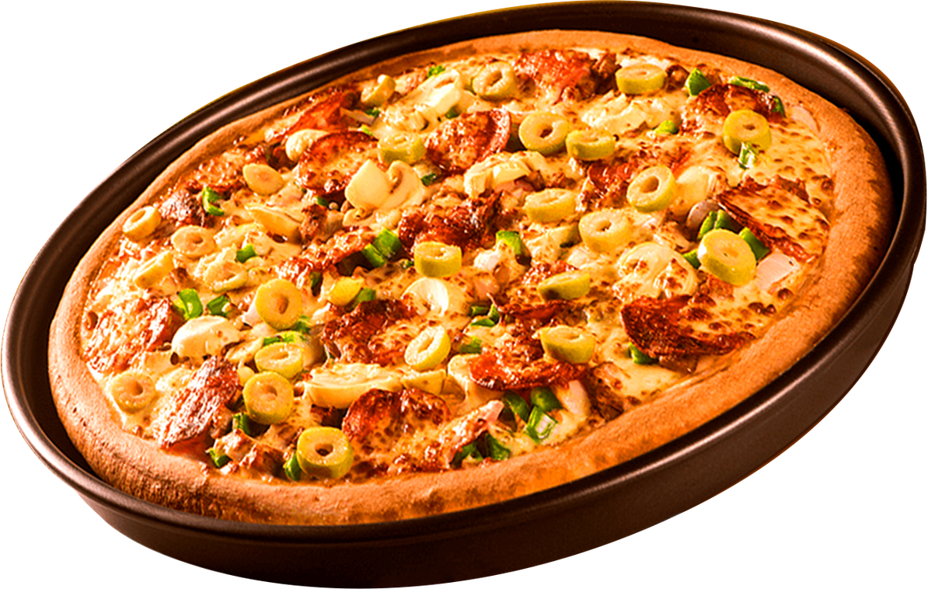


SHODWE
Home
About
Contact
Pizza Resto
PIZZA
RESTO
WHERE EVERY SLICE TELLS A STORY

Slide 2

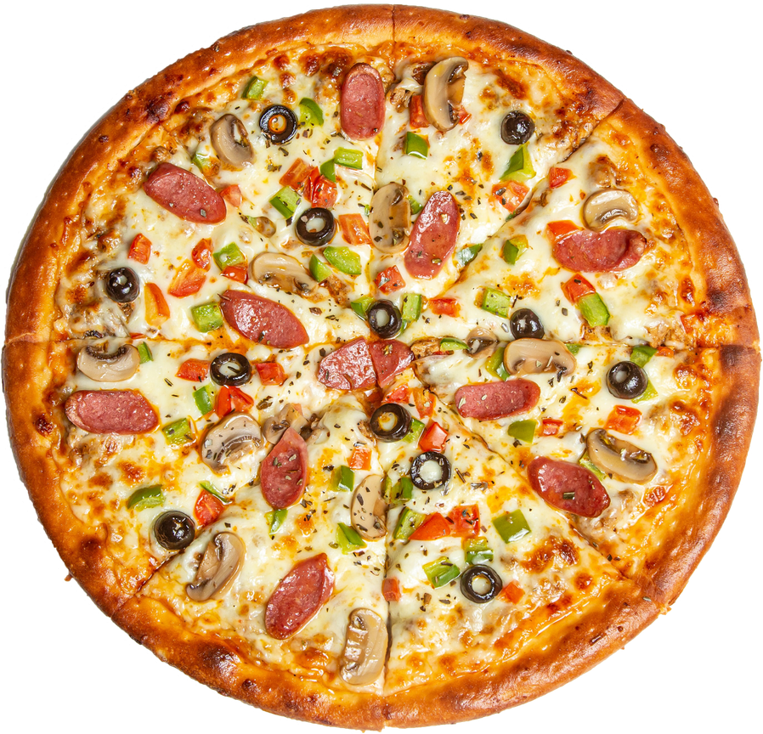
SHODWE
Home
About
Contact
Pizza Resto
HELLO MY NAME IS SANDESH AND THIS PROJECT I HAVE UTILIZED SQL QUERIES TO SOLVE A QUESTIONS THAT WERE RELETED TO PIZZA SALES.

Slide 3


RETRIEVE THE TOTAL NUMBER OF ORDERS PLACED.
Home
About

Slide 4
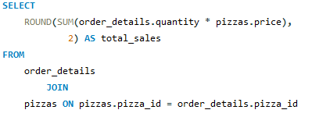

CALCULATE THE TOTAL REVENUE GENERATED FROM PIZZA SALES.
About

Slide 5
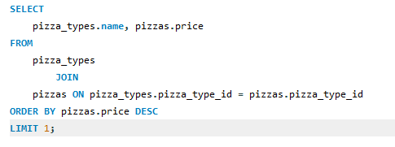

IDENTIFY THE HIGHESTPRICED PIZZA.

Slide 6

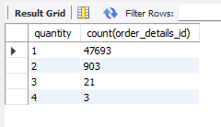
IDENTIFY THE MOST COMMON PIZZA SIZE ORDERED.
Home
About
Contact

Slide 7
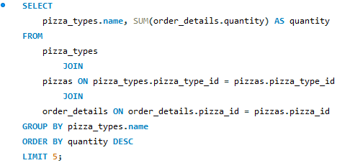
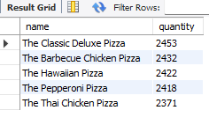
LIST THE TOP 5 MOST ORDERED PIZZA TYPES ALONG WITH THEIR QUANTITIES.

Slide 8
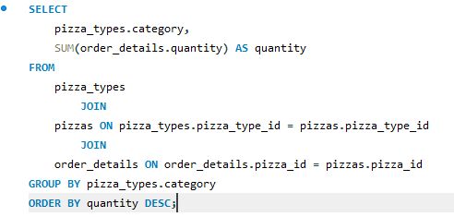
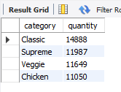
JOIN THE NECESSARY TABLES TO FIND THE TOTAL QUANTITY OF EACH PIZZA CATEGORY ORDERED.

Slide 9
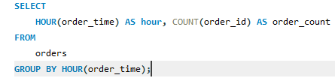
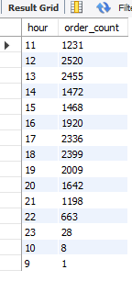
DETERMINE THE DISTRIBUTION OF ORDERS BY HOUR OF THE DAY.

Slide 10

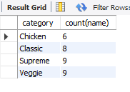
JOIN RELEVANT TABLES TO FIND THE CATEGORY-WISE DISTRIBUTION OF PIZZAS.

Slide 11
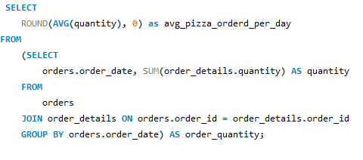

GROUP THE ORDERS BY DATE AND CALCULATE THE AVERAGE NUMBER OF PIZZAS ORDERED PER DAY.

Slide 12
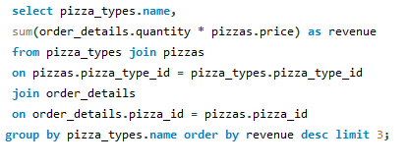
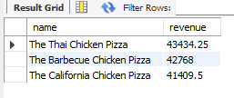
DETERMINE THE TOP 3 MOST ORDERED PIZZA TYPES BASED ON REVENUE

Slide 13
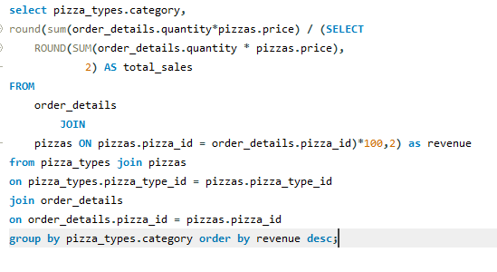
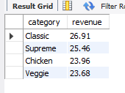
CALCULATE THE PERCENTAGE CONTRIBUTION OF EACH PIZZA TYPE TO TOTAL REVENUE

Slide 14
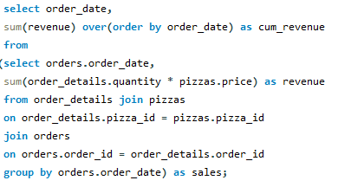
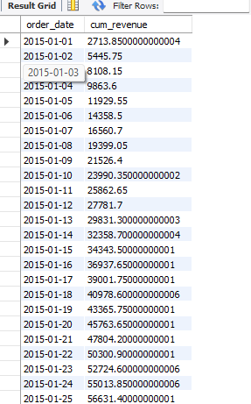
ANALYZE THE CUMULATIVE REVENUE GENERATED OVER TIME

Slide 15
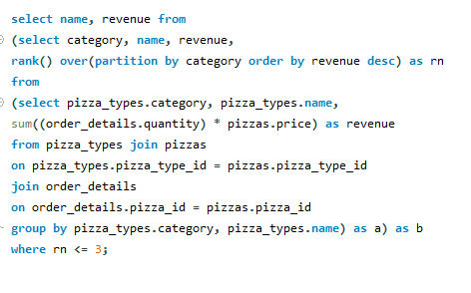
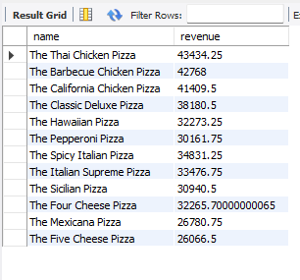
DETERMINE THE TOP 3 MOST ORDERED PIZZA TYPES BASED ON REVENUE FOR EACH PIZZA CATEGORY

Slide 16
SHODWE
Home
About
Contact
Pizza Resto
THANK YOU
FOR ATTENTION
2025 PIZZA RESTO PRESENTATION

